Slide 1
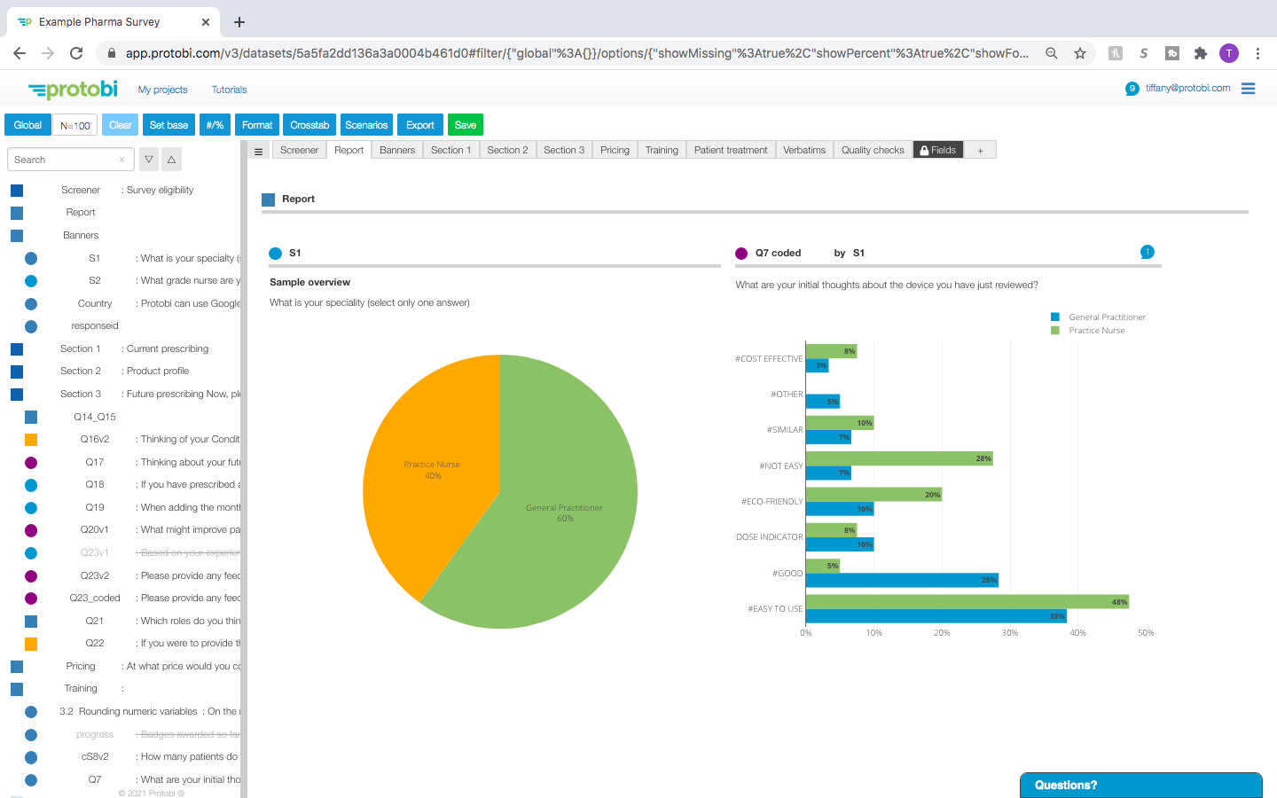
Protobi’s quick-start tutorial
January, 2021
support@protobi.com

Slide 2
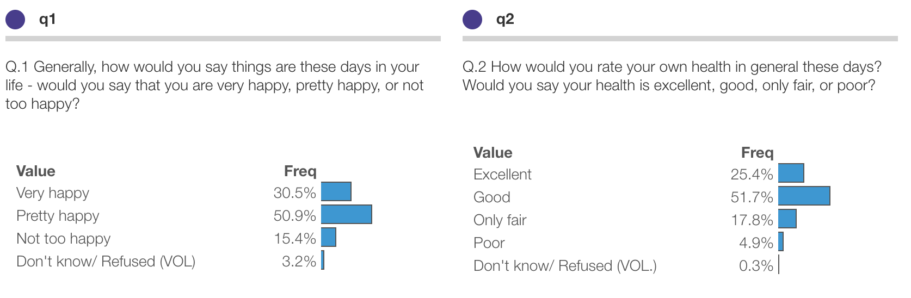
How are you doing? A quantitative look…
Each survey question is an interactive chart
Bars show distribution of responses

Slide 3
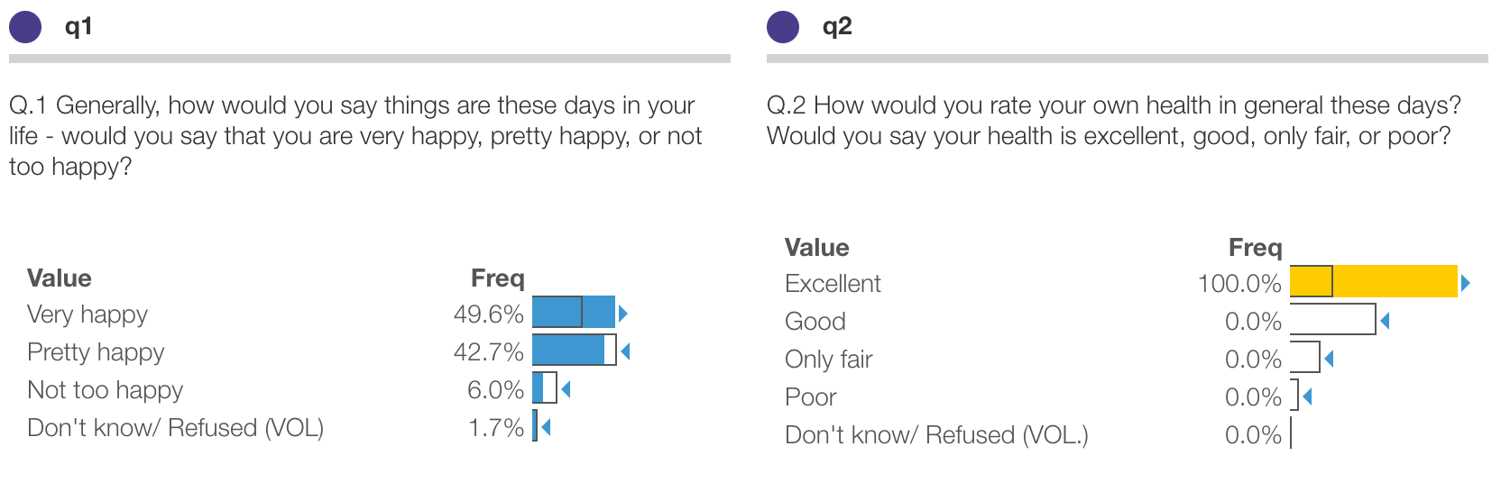
Press on a value to see survey responses from that subset only
Press on a value and the entire survey will only show data for respondents who selected that value
Solid colors show frequencies for the current subset
Thin outlines show the baseline
Triangles indicate significant differences

Slide 4
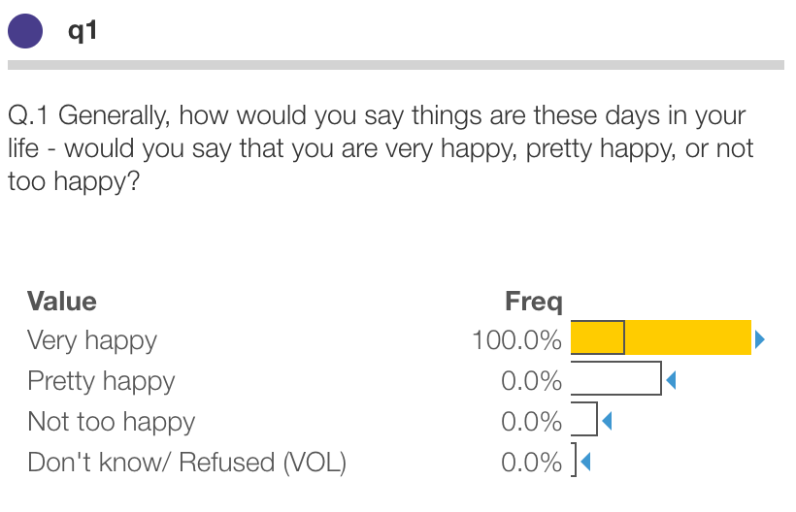
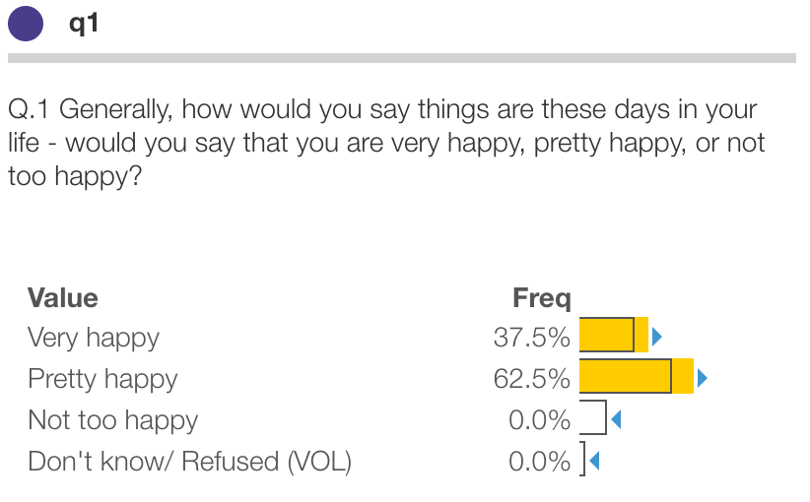
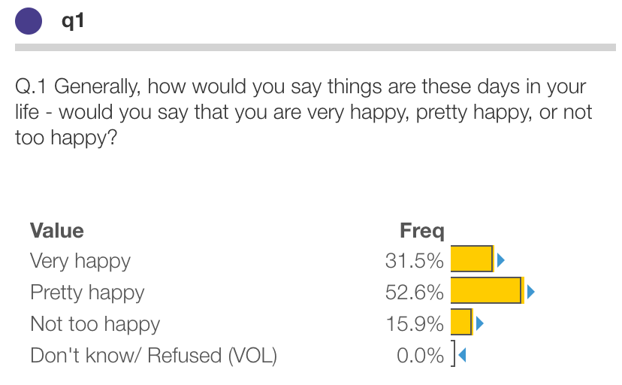
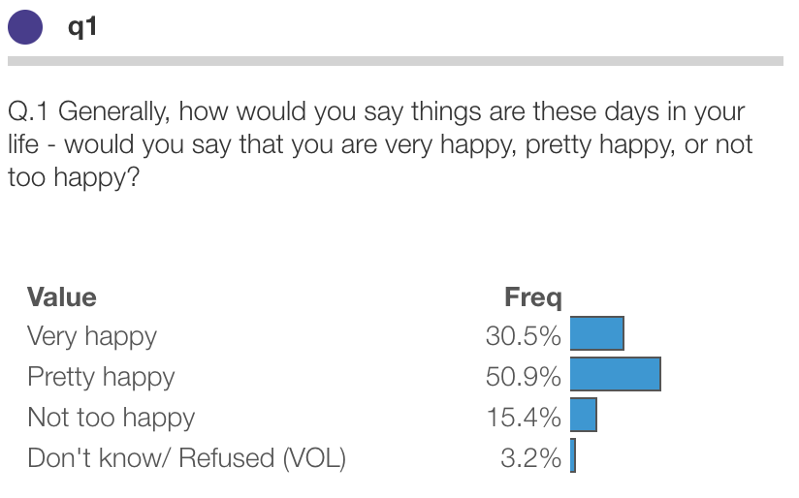

Press on more than one value to create compound queries
Option/alt + press to filter on multiple values (“OR”)
Press to filter on one value (“IS”)
Press the selected group again to clear. You can also use the Clear button on the toolbar (ESC).
Shift + press to exclude a value (“NOT”)

Slide 5
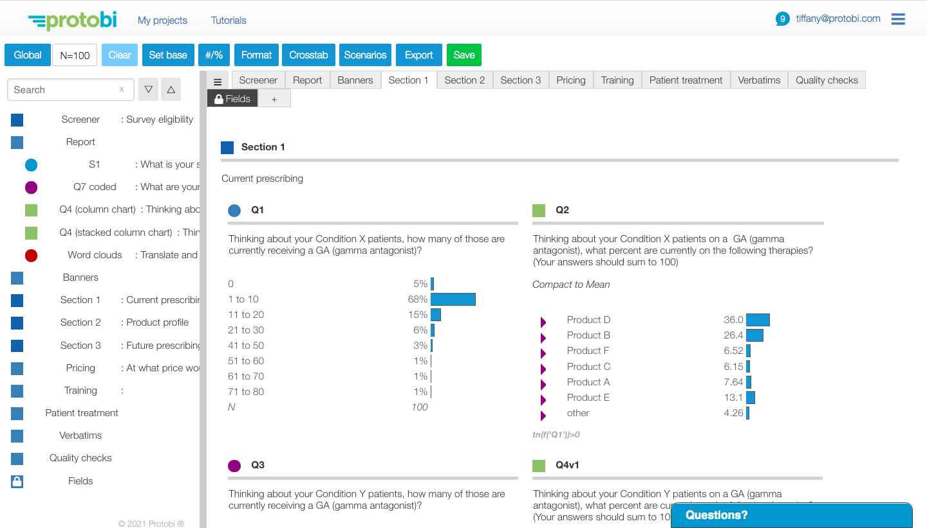
Questions are in a concise list on the left and in charts on the right
Press on the tabs to view the questions within each section as charts
Press the square icon to see the questions in each survey section
Double press on an item to pan the view to that question

Slide 6
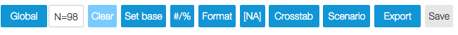
Use the toolbar to modify the project view
Current sample size. Click to see current filters
Set current filters as baseline for stats comparisons
Toggle to display raw or formatted values
Drag an element here to create global crosstabs
Export selected elements to PowerPoint or Excel
Global filters, e.g. "Completes" or "All respondents
Clear all current filters
Toggle to display counts or percentages
Toggle to include blank/missing/skipped values in percentages
Select or define filters for quick reference
Save changes to the view

Slide 7
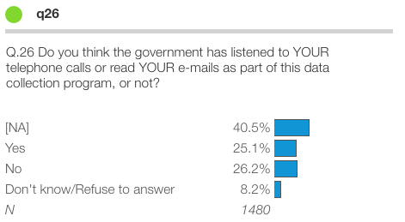
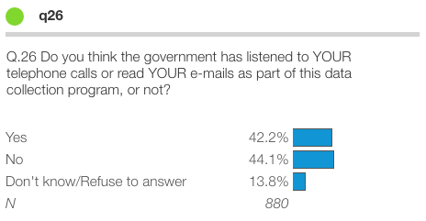


Change the view to include or hide missing values
Missing values are not included in the N size when [NA] is deselected from the toolbar

Slide 8
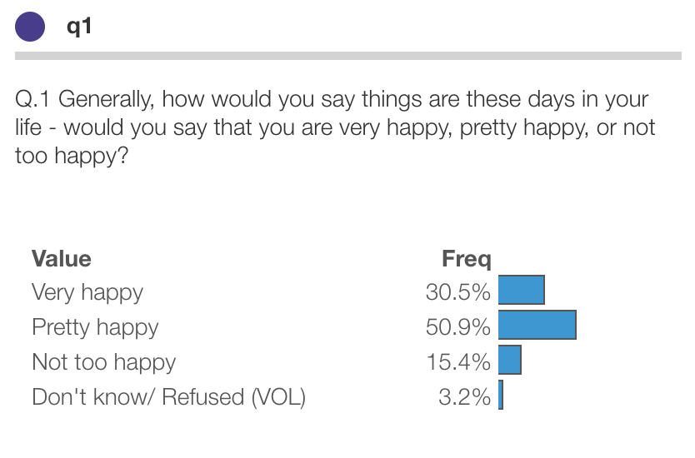
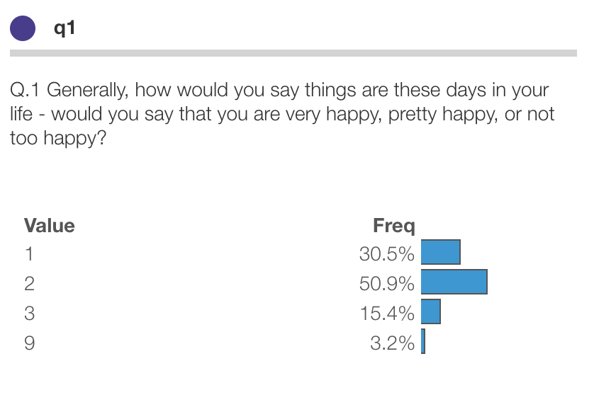


View labeled values or underlying raw values
Labeled values as seen by survey respondents
Raw values from the datafile

Slide 9
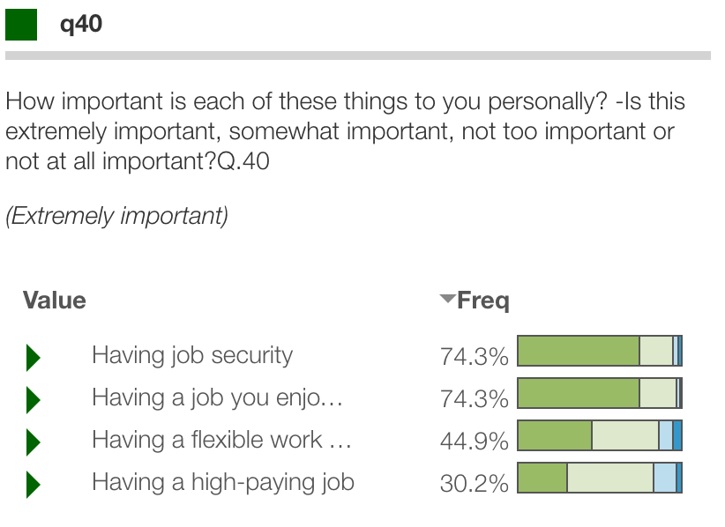
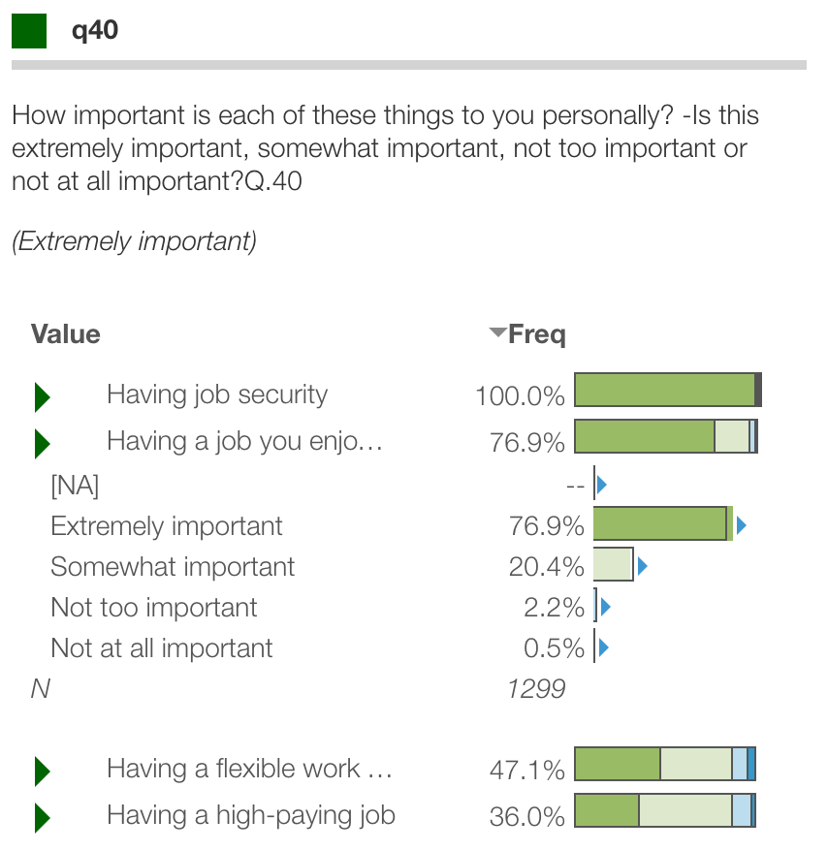
See the full distribution of values for collapsed groups
Questions with the same response values collapsed into a compact value (e.g. Extremely important)
Press the triangle ( ) to see the full distribution of responses
Bars here are stacked with each color representing a different value in the distribution

Slide 10
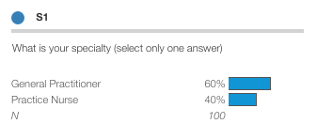
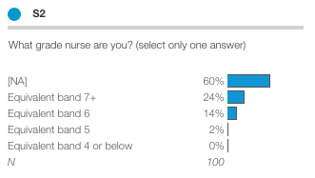
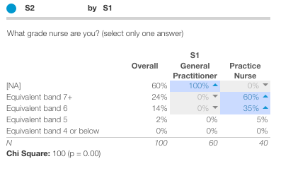
Drag questions to create crosstabs
Drag one element onto another to create a crosstab
To remove a crosstab drag it away from the element

Slide 11
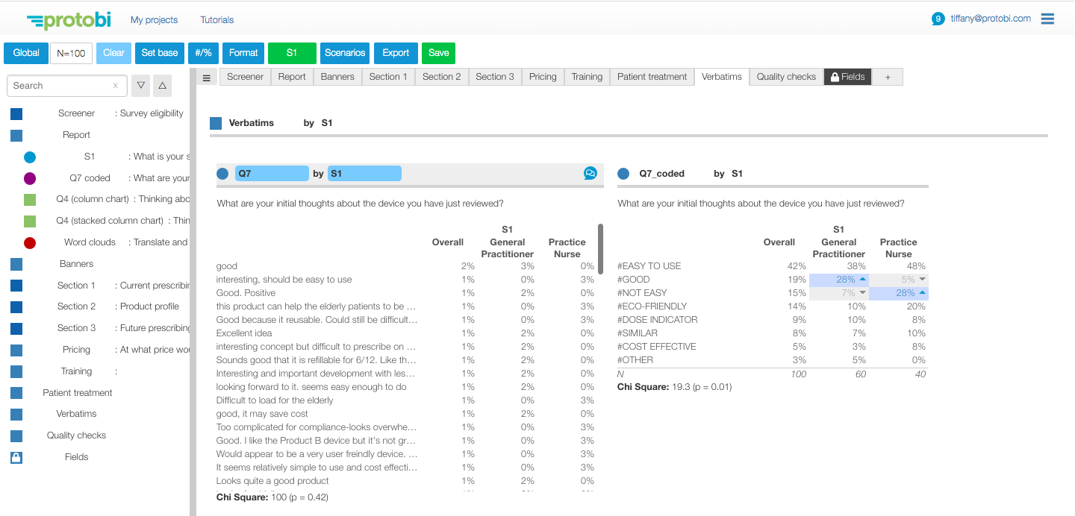
Apply the same crosstab to every question
Drag an element to the crosstab button

Slide 12
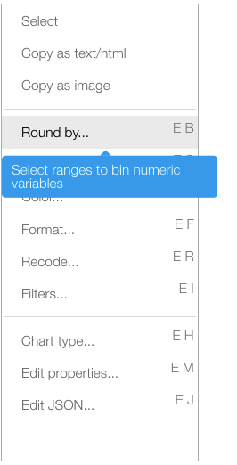
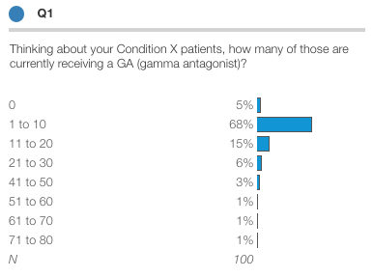
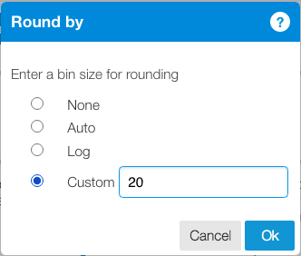
Group values into custom ranges
Auto — Select linear ranges based on observed variation
Log — Uses logarithmic ranges
Custom – Enter a number for equal ranges or a list of cut-points, e.g. 10,25,50

Slide 13
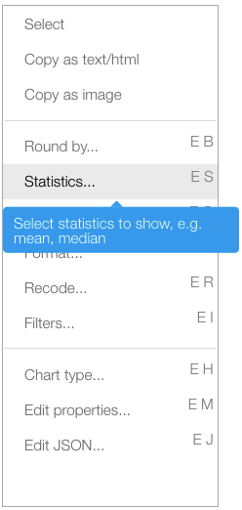
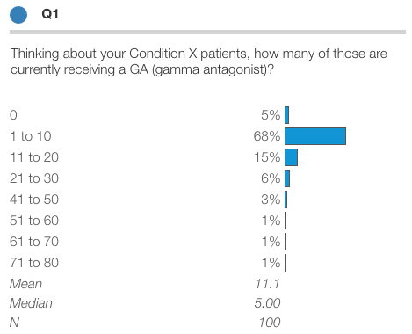
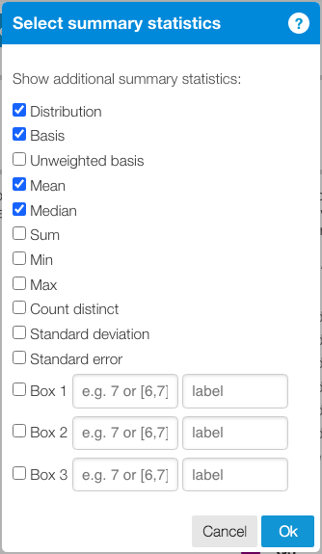
Show means, medians and other summary statistics
Select pre-defined statistics
Create custom statistics, e.g. [6,7] top box scores for scale questions

Slide 14
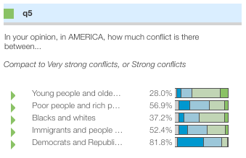
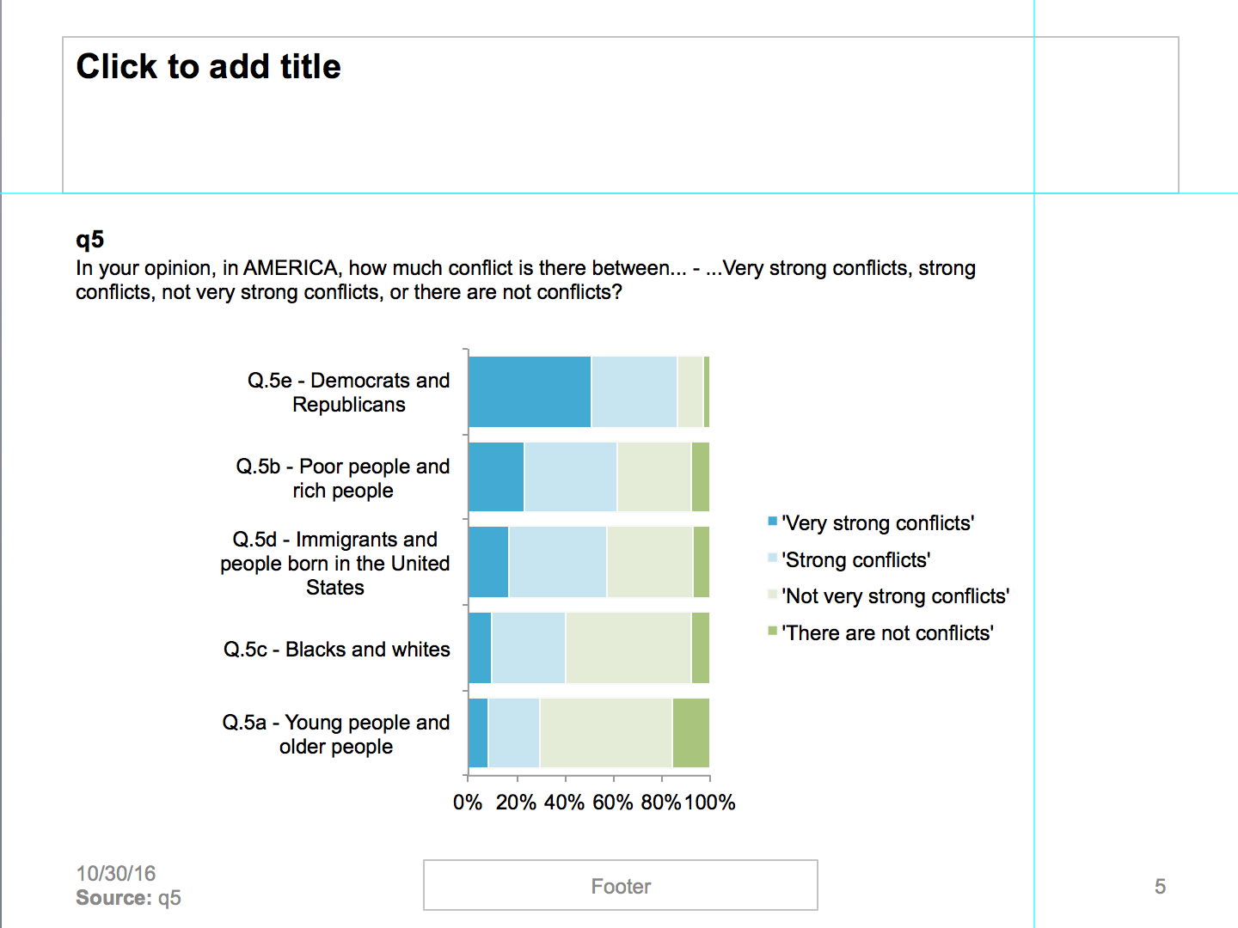
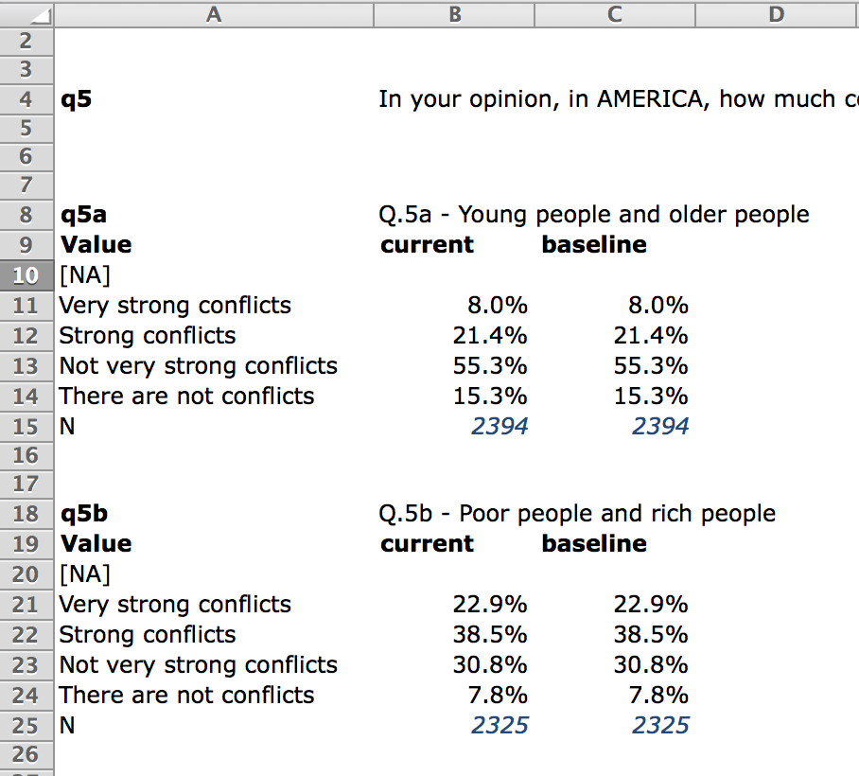
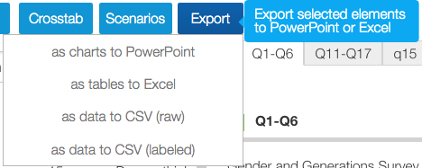
Export selected elements to Excel or PowerPoint
1) Press the header area to select element(s)
Charts export to PowerPoint as native objects
2) Choose an export format from the toolbar

Slide 15
Sign into Protobi
Go to https://app.protobi.com in your browser
Enter your email and press “Send sign-in link”
A link will be emailed to you. Press on the link, or use the login token to complete sign-in.
Alternatively, sign in with Google or Okta Authentication

Slide 16

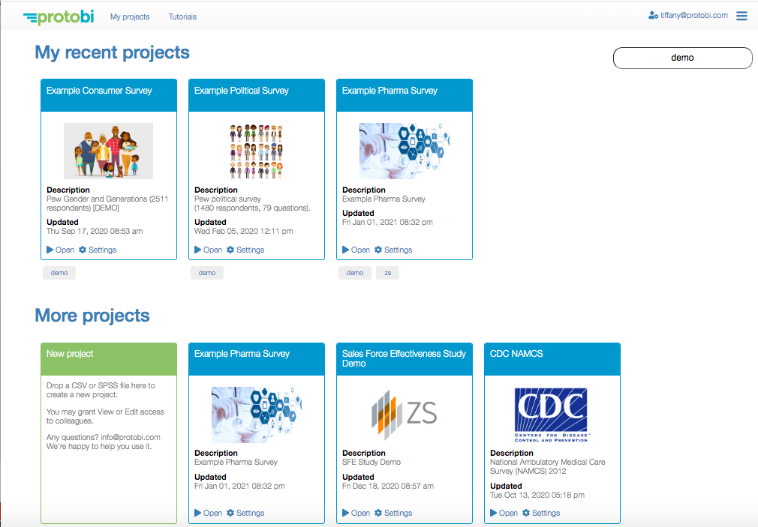
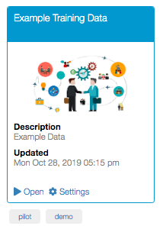
Access your projects
Press ”My projects” link to see this page
Project are organized by most recent activity

Slide 17
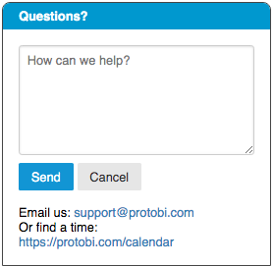

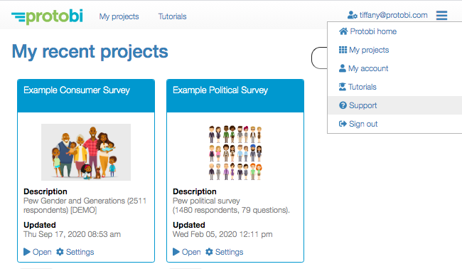

Need help?
Create a new support ticket within the app
See existing support tickets at https://protobi.freshdesk.com
Or email us at support@protobi.com

